Slide 1

Loss Cost Model Building
Vani S. and Aurelya W.

Slide 2
01
Building the Severity Model
AGENDA
02
Building the Freq x Severity Model
03
Building the Tweedie Model
04
Comparing the Two Loss Cost Models

Slide 3
Part I: Severity Model

Slide 4
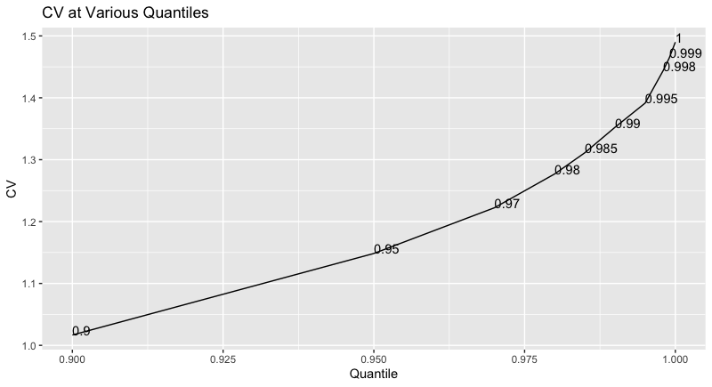
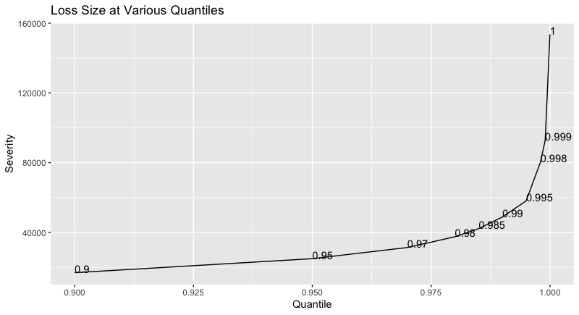
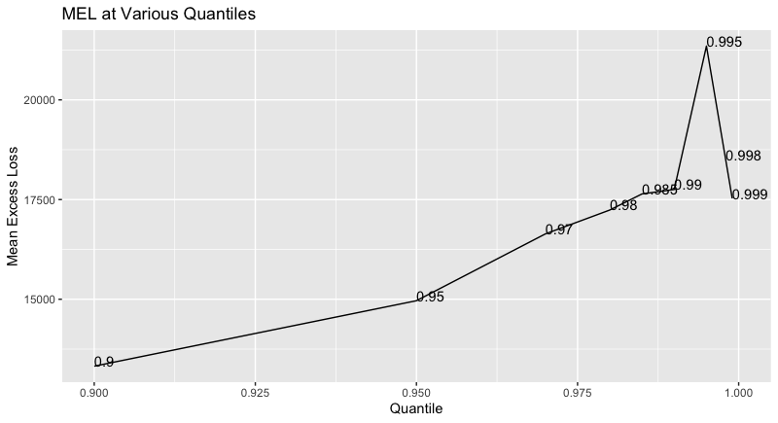
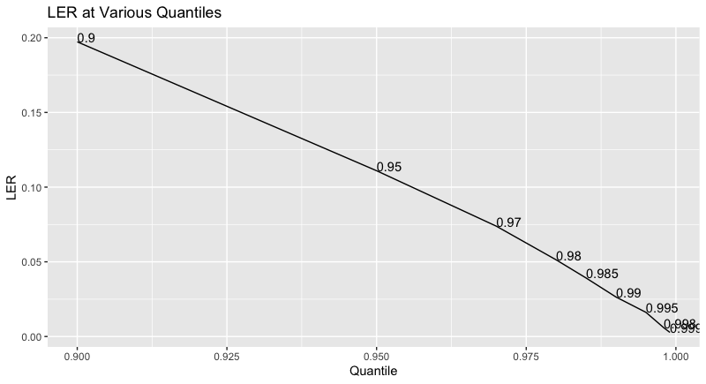

Slide 5
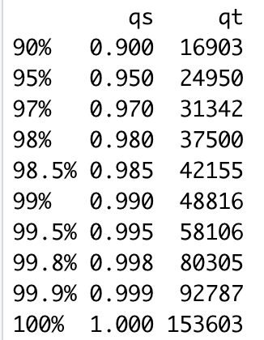
Response Variate Capping
Looking at the plots in the previous slide, the 99.5% percentile seems like the best point to cap the severity variate.
The variate is capped at 58106.

Slide 6
EDA Approach
For each variate added to the model, the following was verified:
Is the variate’s coefficient(s) reasonable?
Is the variate’s coefficient(s) significant?
Is the variate time consistent?
Does adding the variate to the model pass the F-Test?
Does adding the variate to the model pass the parsimony tests (AIC/BIC)?
Does adding the variate to the model increase the mean CV gini? (more on this later)

Slide 7
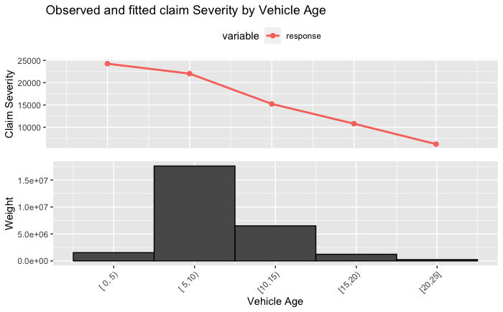
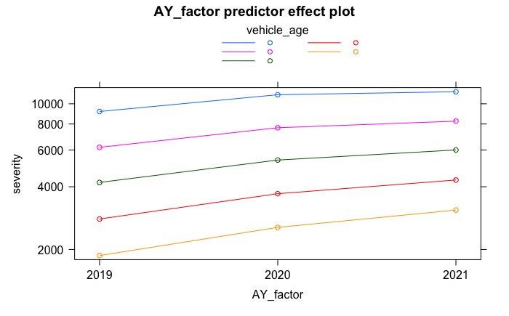
EDA Example: vehicle_age
Calculated by finding the time between model year and the policy’s term effective date
AIC and BIC decreases
F-Test is passed
Coefficient is negative
As policy vehicles get older, severity decreases.

Slide 8
Examples
Variate Name | Description | Included in Model? | Notes
new_policy | A 2-level categorical variate indicating whether the term effective date of the policy is the same as the inception date | N | The coefficient for the variate was no longer significant once other variates were added.
vehicle_age | A continuous variate for the age of the vehicle being insured. Calculated by finding the time between model year and the policy’s term effective date | Y | Capped at 23 years.
agecat | An ordinal variate grouping policyholders based on their age. | Y | group 1: less than 25, group 2: 25-35, group 3: 36-50, group 4: 51-65, group 5: over 65. Missing age was replaced with the mean.

Slide 9
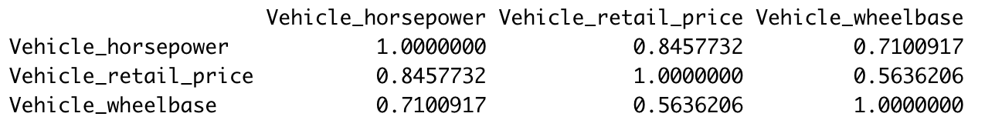
Retail Price, Horsepower and Wheelbase
These variates are heavily correlated, and thus, we can only include one in the model.
Which one should we use?

Slide 10
Model | CV mean Gini
severity ~ AY_factor | 0.07391234
severity ~ AY_factor + new_policy | 0.09874314
severity ~ AY_factor + new_policy + vehicle_age | 0.24061942
severity ~ AY_factor + vehicle_age +agecat + new_policy | 0.26318008
severity ~ AY_factor + vehicle_age +agecat + Liab_driving_record_Ind | 0.27186995
severity ~ AY_factor + vehicle_age +agecat+ Liab_driving_record_Ind + Marital_status_Ind | 0.27412673
severity ~ AY_factor + vehicle_age +agecat + + Marital_status_Ind + Liab_driving_record_Ind + Num_at_fault_claims_past_1_yr_Ind | 0.27421537
severity ~ AY_factor + vehicle_age +agecat + Liab_driving_record_Ind + Marital_status_Ind + Num_at_fault_claims_past_1_yr_Ind + Vehicle_retail_price | 0.28624359
severity ~ AY_factor + vehicle_age +agecat + Liab_driving_record_Ind + Marital_status_Ind + Num_at_fault_claims_past_1_yr_Ind + Vehicle_horsepower | 0.27797495
severity ~ AY_factor + vehicle_age +agecat + Liab_driving_record_Ind + Marital_status_Ind + Num_at_fault_claims_past_1_yr_Ind + Vehicle_wheelbase | 0.27522263
We will test these 2 models on our holdout data!

Slide 11
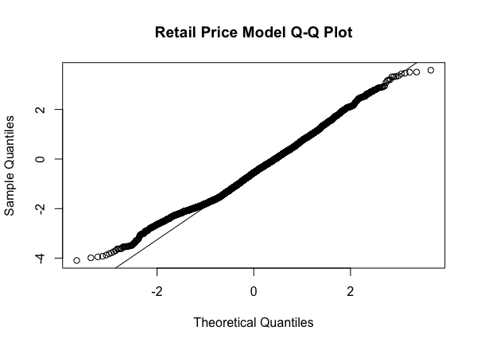
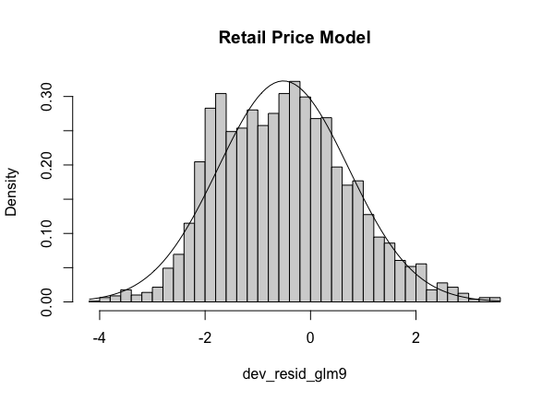
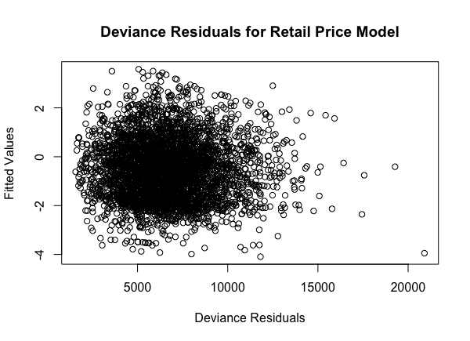
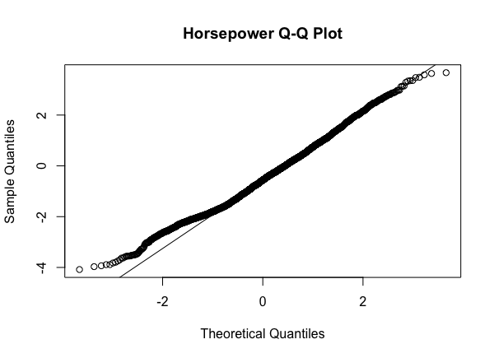
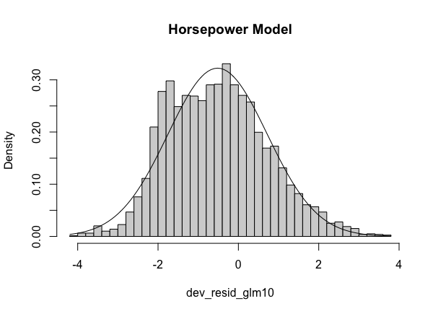
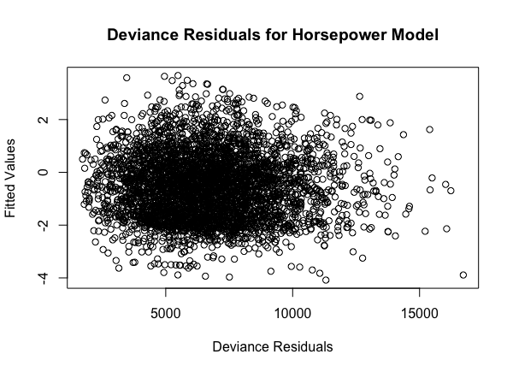
Error Assumptions

Slide 12
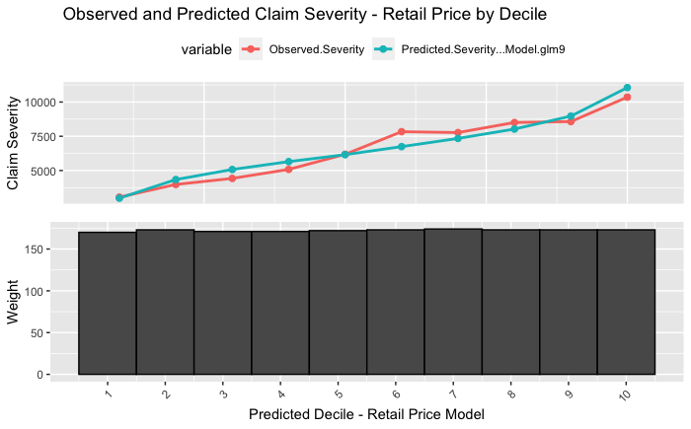
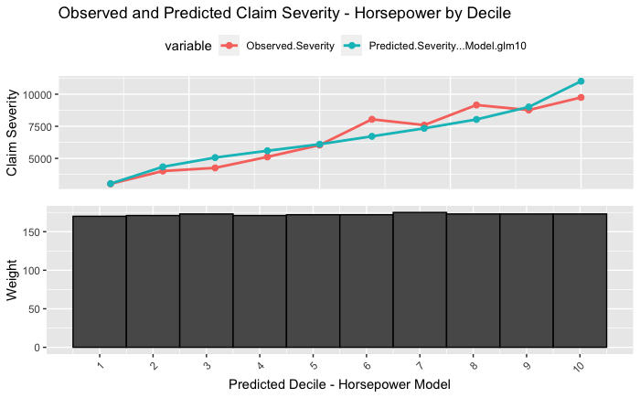
Simple Quantile Plot

Slide 13
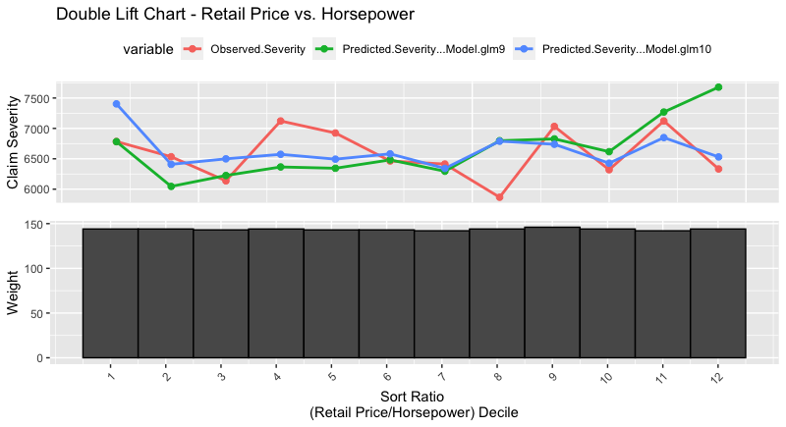
Double-Lift Chart
The retail price model performs better at the left tail of the data.
The horsepower model performs better at the right tail.
There is a lot of overlap between the 2 models near the middle of the data.

Slide 14
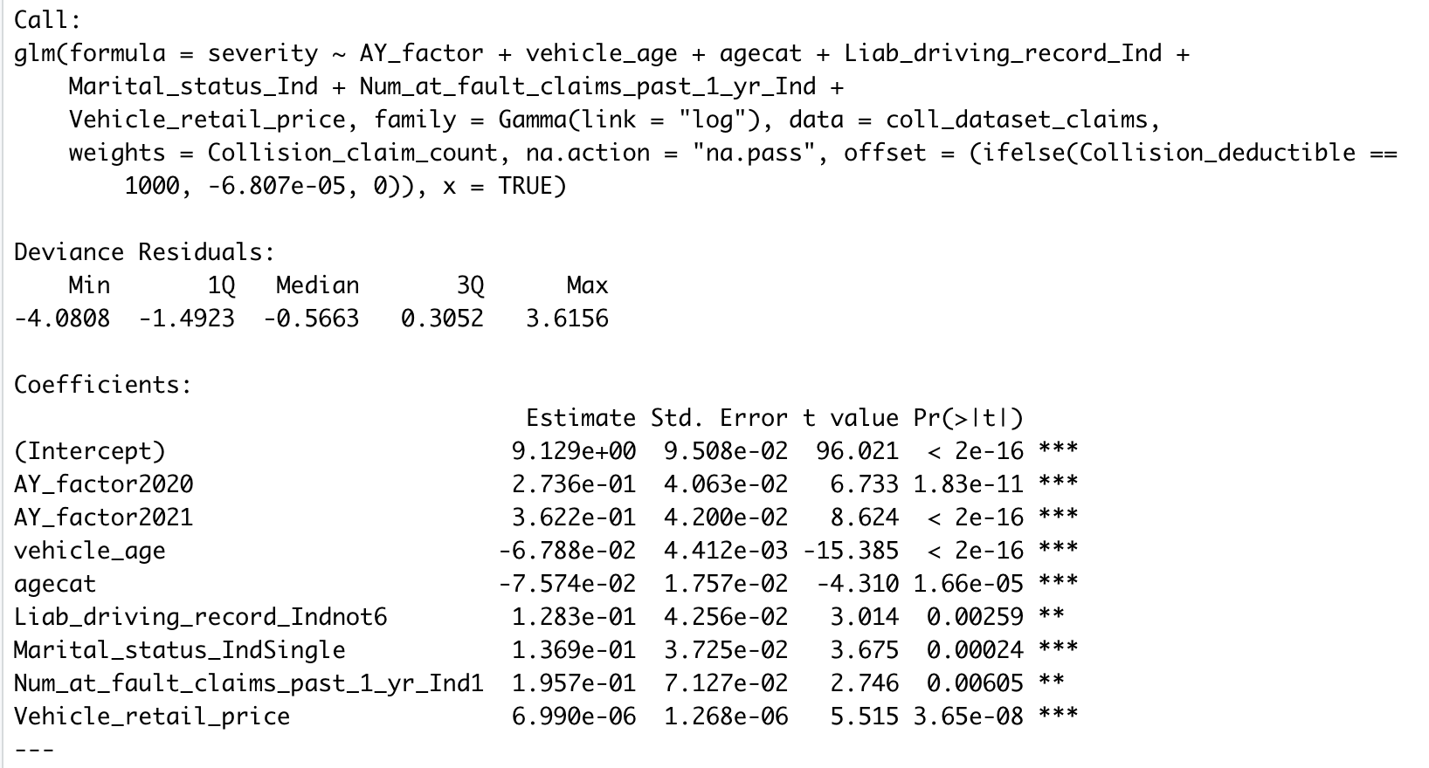
Picking the Final Severity Model
Retail Price Model | Horsepower Model
0.3496045 | 0.3433404

Slide 15
Part II: FS Model

Slide 16
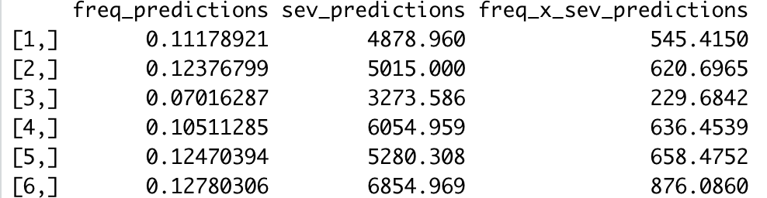
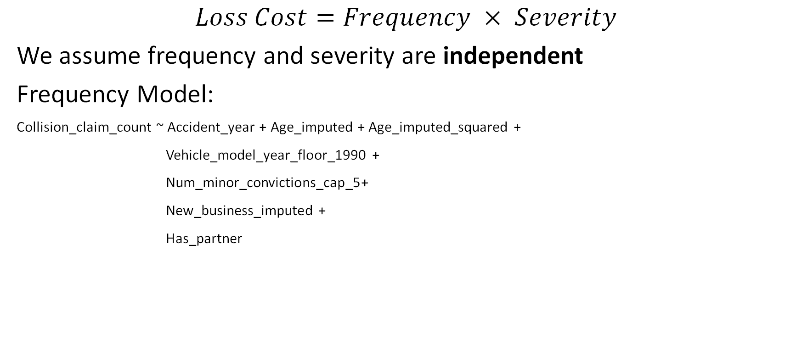
Loss Cost
$$Loss Cost=Frequency × Severity$$
We assume frequency and severity are independent
Frequency Model:
Collision_claim_count ~ Accident_year + Age_imputed + Age_imputed_squared +
Vehicle_model_year_floor_1990 +
Num_minor_convictions_cap_5+
New_business_imputed +
Has_partner
Holdout Gini for this approach:
0.3650815

Slide 17
Part III: Tweedie Model
Notes:
Next, instead of fitting one model for frequency and another model severity models, we are going to directly fit the loss cost on a Tweedie moddel.

Slide 18
Assumptions
Tweedie distribution assumes that frequency and severity are positively correlated.
Tweedie distribution is fairly robust to violation of this assumptions.
Notes:
The Tweedie assumes that frequency and severity of a policy are positively correlated.
However, this assumption would be violated in real life, but the Tweedie still works pretty well despite this.

Slide 19
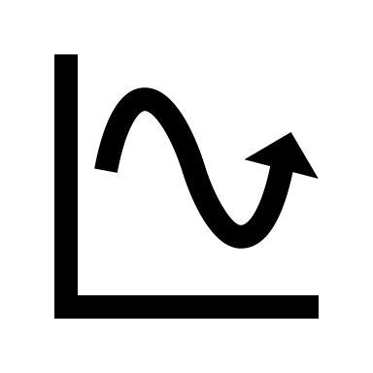

Treating Missing Values
CONTINUOUS
CATEGORICAL
Mean/Median
Group with the most exposure
Notes:
First off, from our data, there are some missing values. For continuous data, it would be replaced by its mean/median and for categorical, it would be replaced by the group with the highest amount of exposure.

Slide 20
Base Model
Lost_cost ~ Accident_year
Notes:
State that p = 1.5
Now, we would build the model, starting from the base of only having accident year as a factor. The p that we would use would be 1.5, because it’s in the middle of 1 and 2.

Slide 21
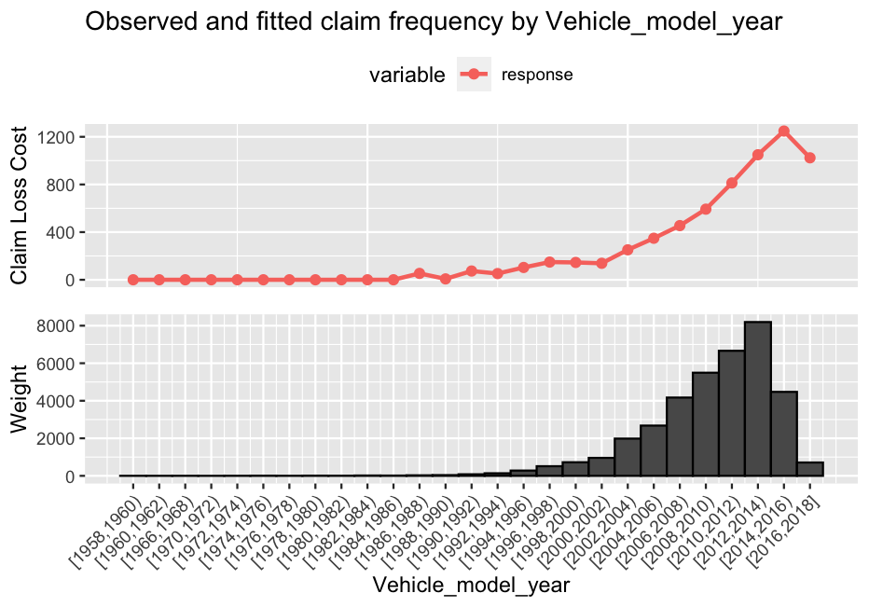
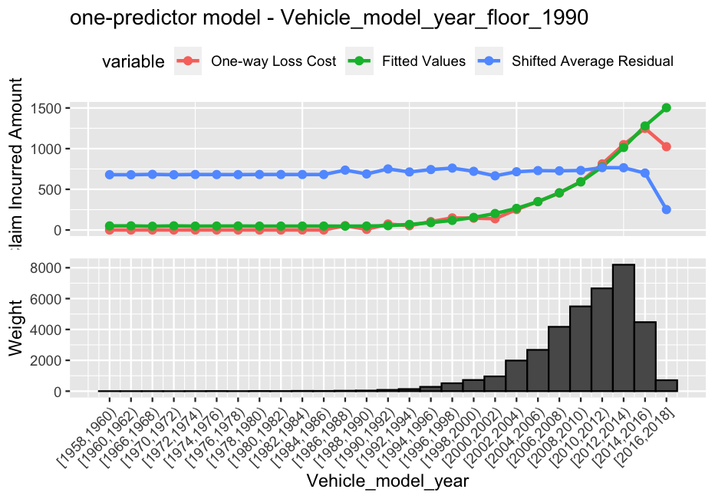
1st Variable Added – One-Way Analysis
Notes:
So the first variables that is added to the base model is Vehicle_model_year.
From the on-way analysis residual plot, we could see an obvious pattern that the Loss Cost increases as the Vehicle_model_year increases. However, since there is little amount of exposure before year 1990, we would floor it there.
By doing this flooring, we obtain the fit that is shown on the the graph at the right. Notice that it doesn’t do well in fitting the tail. Therefore, we would like to take a look at this further.

Slide 22
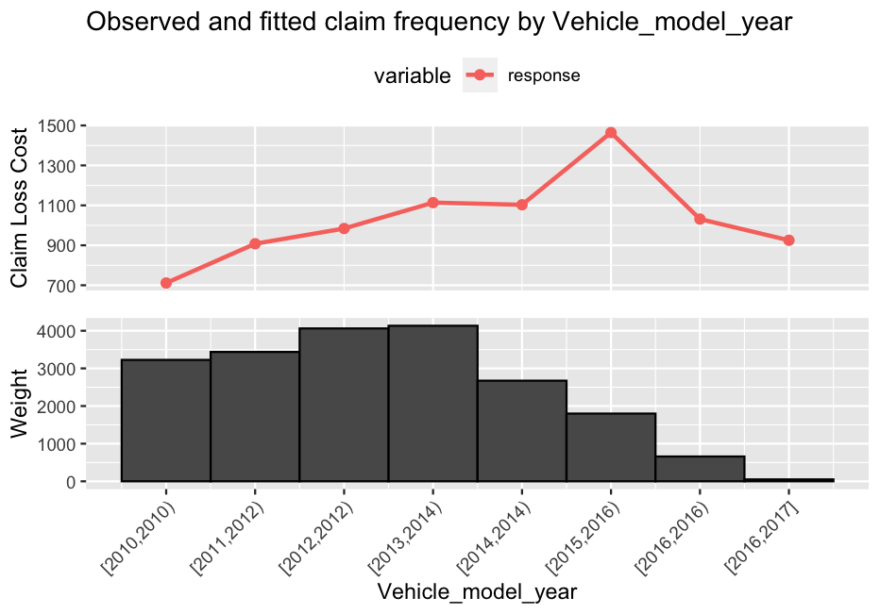
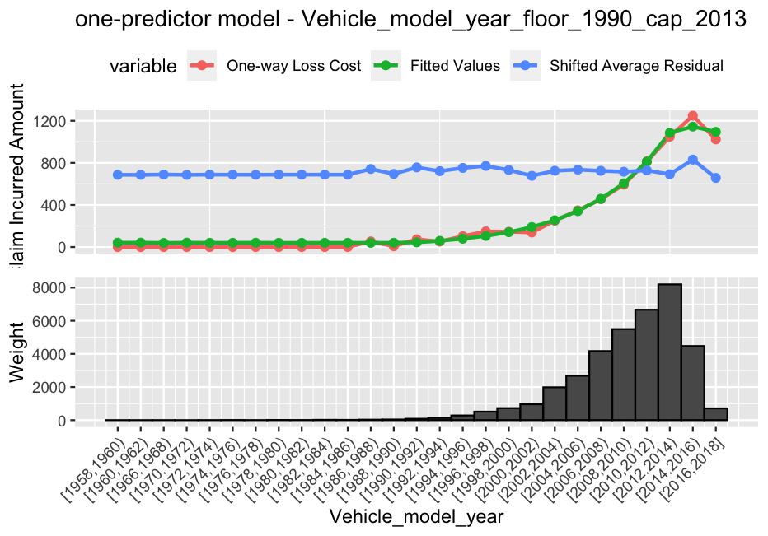
1st Variable Added – One-Way Analysis
Notes:
For the tail it looks like it’s going up and then going down. Since we are unsure of this patter after 2013, we would like to give a cap in 2013 as well and obtain the result here.

Slide 23
1st Variable Added – CV Gini
Variable (Accident_year + _ ) | CV Gini (Training) | AIC
 | -0.018240 | 84,591
Vehicle_model_year_floor_2019 | 0.279 | 84,389
Vehicle_model_year_floor_2019_cap_2013 | 0.276 | 84,393
Vehicle_retail_price | 0.080 | 84,576
Vehicle_horsepower | 0.114 | 84,566
Num_minor_convictions | 0.118 | 84,555
Has_partner | 0.118 | 84,568
New_business | 0.076 | 84,563
Years_driving | 0.170 | 84,538
Age_imputed | 0.170 | 84,547
Notes:
Another reason why Vehicle_model_year is important is that when we do the fitting, it shows the greatest increase in the CV Gini and the greatest decrease in AIC. And the difference in this increase and decrerase is by a lot as we see in the table here.
As we previously mentioned, we try to add different variables to our base model. So, aside from looking at our one-way analysis, we also look at the Gini and AIC. …
So because of this, it solidifies our reasoning to put Vehicle model year in our model.

Slide 24
1st Variable Added – CV Gini
Variable (Accident_year + _ ) | CV Gini (Training) | AIC
 | -0.018240 | 84,591
Vehicle_age_cap_30 | 0.2923337 | 84,382
Vehicle_age_cap_30_floor_4.5 | 0.2924199 | 84,396
Vehicle_retail_price
Vehicle_horsepower
Num_minor_convictions
Has_partner
New_business
Years_driving
Age_imputed
Notes:
Another reason why Vehicle_model_year is important is that when we do the fitting, it shows the greatest increase in the CV Gini and the greatest decrease in AIC. And the difference in this increase and decrerase is by a lot as we see in the table here.
As we previously mentioned, we try to add different variables to our base model. So, aside from looking at our one-way analysis, we also look at the Gini and AIC. …
So because of this, it solidifies our reasoning to put Vehicle model year in our model.

Slide 25
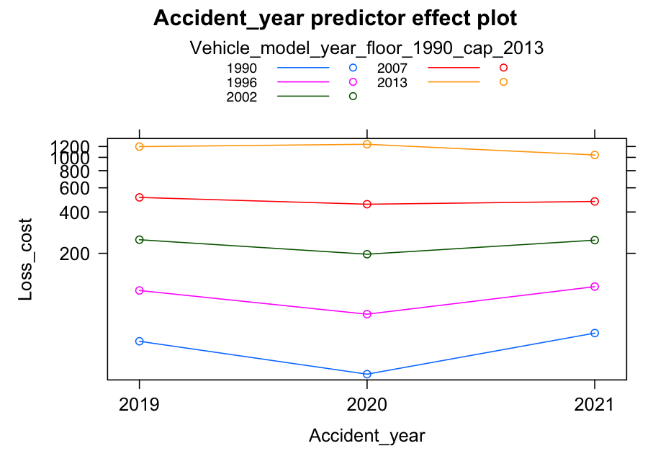
1st Variable Added – Tests
Reasonability test passed
Significance test passed
Parsimony Test passed - AIC decreases - F-Test’s p-value is significant
Time consistency test passed
Notes:
We also tested all the 4 tests, reasonability, significance, parsimony and time consistency. Vehicle_model_year passed all these 4 tests and therefore, we would go on with it in our model.

Slide 26
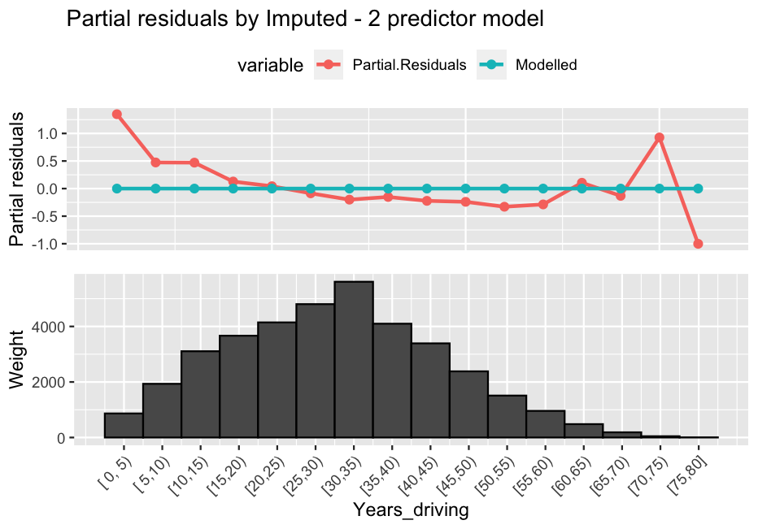
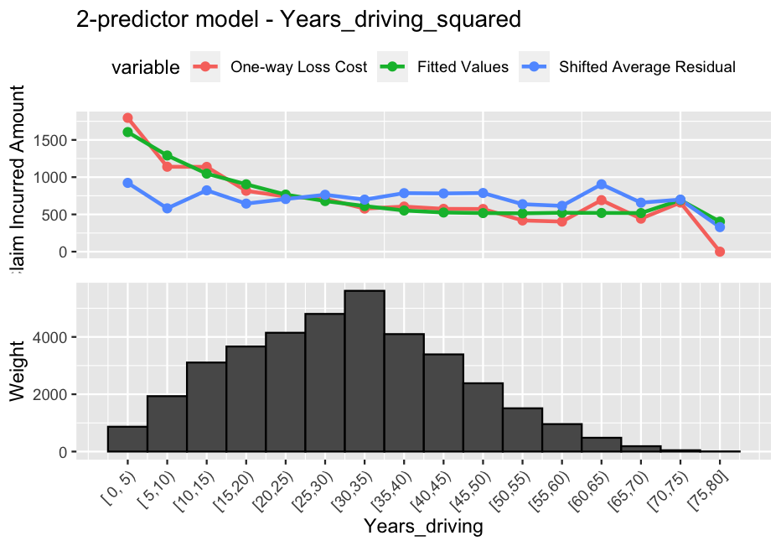
2nd Variable Added – One-Way Analysis
Notes:
Another variable that we think is important would be the Years_driving, which is taken as the difference between term_effective_date and the insured_year_licenced. As we could see from the graph, there is a quadratic pattern and thus, we fit Years_driving and Years_driving_squared to the model to obtain the graph at the right-hand side.

Slide 27
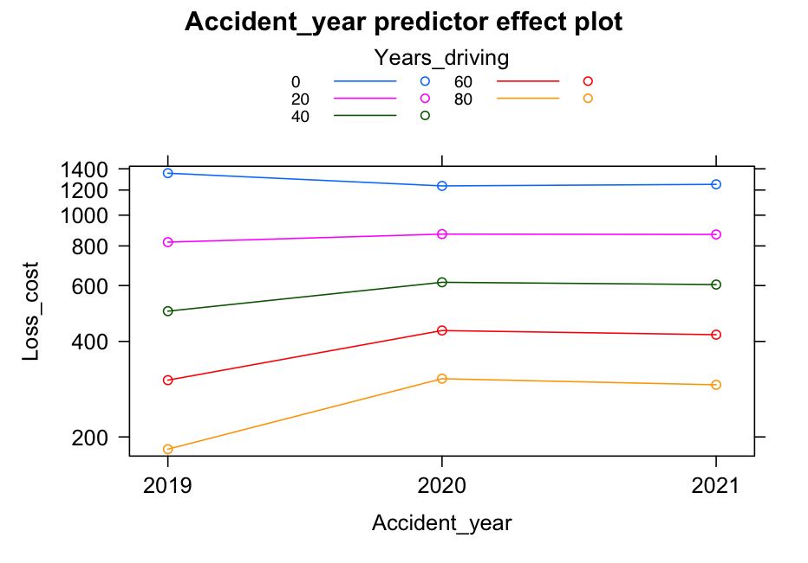
2nd Variable Added – Tests
Reasonability test passed
Significance test passed
Parsimony Test passed - AIC decreases - F-Test’s p-value is significant
Time consistency test passed
Notes:
Years dirving also passed all the 4 tests and thus, we would proceed with it in our model.

Slide 28
Other Variables Added
# | Variable | CV Gini (Training) | AIC
1 | Accident_year | -0.018 | 84,591
2 | + Vehicle_model_year_floor_2019_cap_2013 | 0.276 | 84,393
3 | + Years_driving + Years_driving_squared | 0.319 | 84,355
4 | + Num_minor_convictions_cap_5 | 0.335 | 84,337
5 | + Num_yrs_since_last_at_fault_claim_num_cap_13 | 0.340 | 84,324
6 | + New_business_imputed | 0.350 | 84,308
7 | + Has_partner | 0.354 | 84,298
Notes:
The other variables are added in a similar manner. We added more and more variables to our model and the CV Gini is getting higher and the AIC is getting smaller.
The change eventually converges. Other variables added become not that significant or make the other variables less significant. Thus, we stop after adding 6 variables to our base model.

Slide 29
Other Variables Added
# | Variable | CV Gini (Training) | AIC
1 | Accident_year | -0.018 | 84,591
2 | + Vehicle_age_cap_30_floor_4.5 | 0.292 | 84,382
3 | + Years_driving + Years_driving_squared | 0.331 | 84,342
4 | + Num_minor_convictions_cap_5 | 0.346 | 84,324
5 | + Num_yrs_since_last_at_fault_claim_num_cap_13 | 0.350 | 84,311
6 | + New_business_imputed | 0.358 | 84,297
7 | + Has_partner | 0.362 | 84,286
Notes:
The other variables are added in a similar manner. We added more and more variables to our model and the CV Gini is getting higher and the AIC is getting smaller.
The change eventually converges. Other variables added become not that significant or make the other variables less significant. Thus, we stop after adding 6 variables to our base model.

Slide 30
Choosing p of the Tweedie Distribution
p | CV Gini
1.30 | 0.3534918
1.35 | 0.3535334
1.40 | 0.3536084
1.45 | 0.3536536
1.50 | 0.3537208
1.55 | 0.3537927
1.60 | 0.3538052
1.65 | 0.3538599
1.70 | -0.2366938
There is not much difference in the CV Gini
→ Stay with p = 1.5
Notes:
Now, we would like to look at our p again to see if a different p could lead to a better CV. As we could see from the graph, the difference is at the 4th decimal place and thus, we would still stay with our p of 1.5.

Slide 31
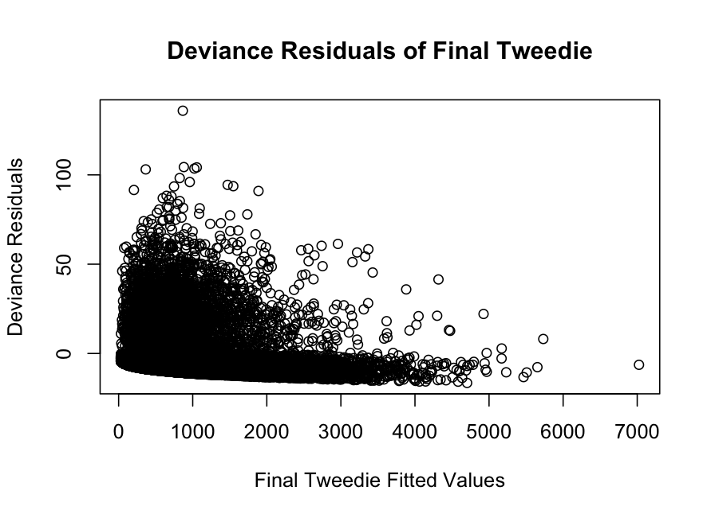
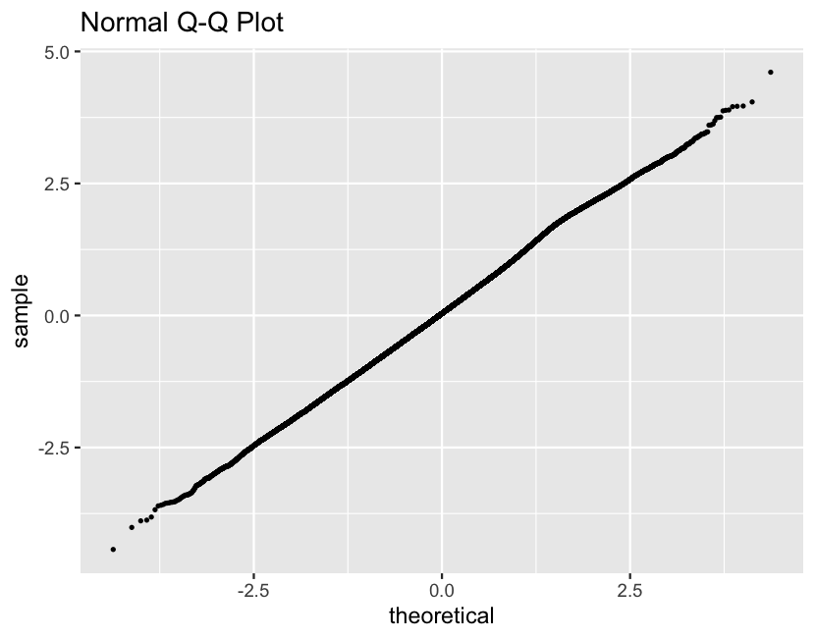

Error Assumptions
Homoscedastic & Random
Normal
Notes:
For this model, our error assumptions are satisfied. It is homoscedastic & random and it is normal as well since the QQ-plot shows a straight line.

Slide 32
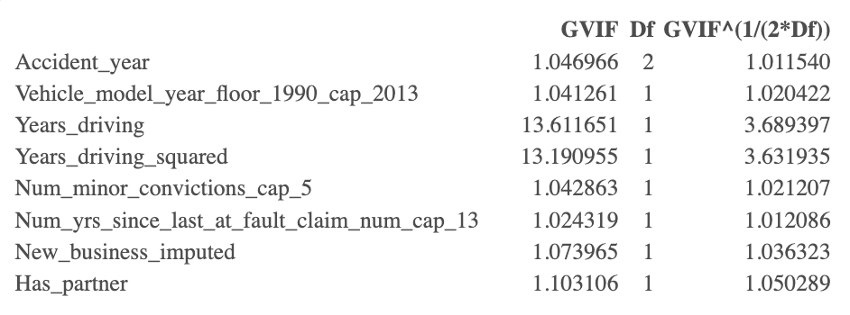
Testing Multicollinearity (VIF)
None is greater than 10, except for Years_driving & Years_driving_squared.
Notes:
The VIF for our variables are also less than 10, except for Years_driving & Years_driving_squared, since they are related.

Slide 33
Holdout Testing – Gini Coefficient
# | Variable | Gini (Holdout)
1 | Accident_year + Vehicle_model_year_floor_2019_cap_2013 + Years_driving + Years_driving_squared + Num_minor_convictions_cap_5 + Has_partner | 0.371
2 | Accident_year + Vehicle_model_year_floor_2019_cap_2013 + Years_driving + Years_driving_squared + Num_minor_convictions_cap_5 + Num_yrs_since_last_at_fault_claim_num_cap_13 + New_business_imputed + Has_partner | 0.374
Notes:
Now, we would like to do holdout testing. Here, we want to see how well our model performs with the holdout data. We also compared it with other models with smaller number of covariates to make sure that it is not overfitting. Here are the two model with the highest holdout Gini and our final model is still better.

Slide 34
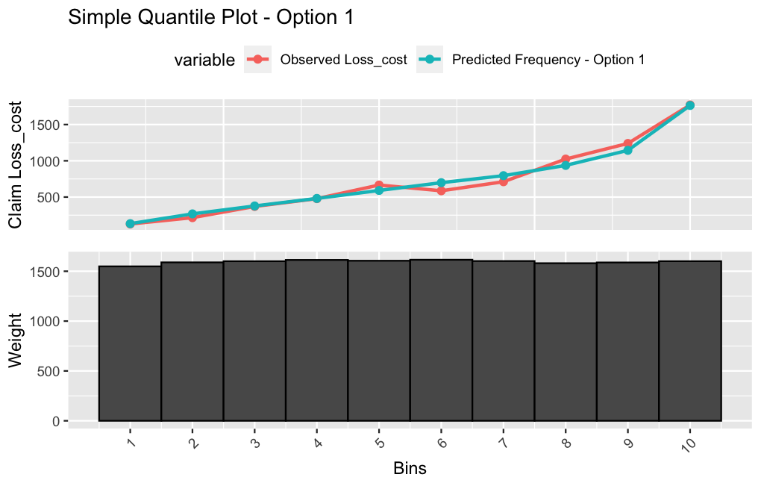
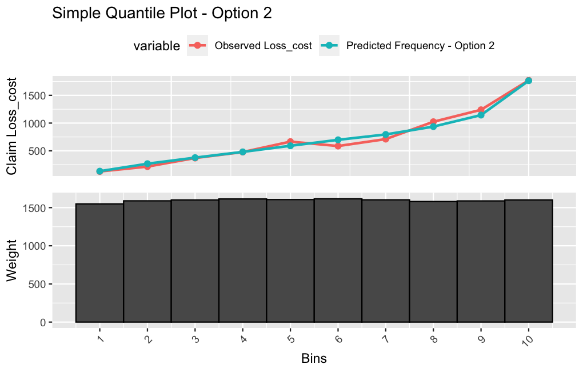
Simple Quantile Plot
Notes:
The simple quantile plots are very similar

Slide 35
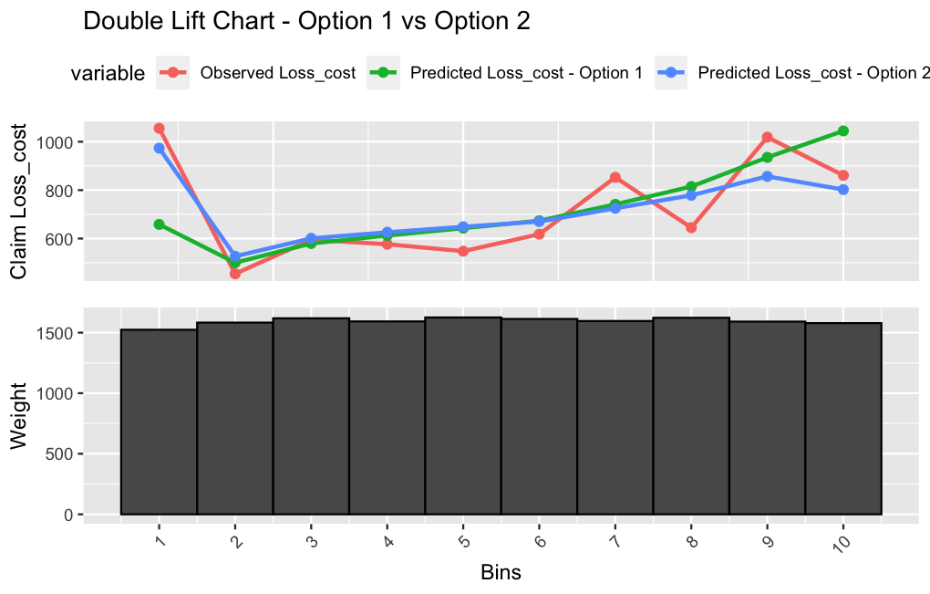
Double-Lift Chart
Similar performance in the middle for both Option 1 & Option 2.
Option 2 performs much better at the ends.
Notes:
And the double lift chart still indicates that our final model with 7 vaiables is still better.
Thus, it would be our final Tweedie Model.

Slide 36
Part IV: Choosing the Final Model
Notes:
Now, we would like to compare the final Freqency x Severity model with our Tweedie model to see which one performs better.

Slide 37
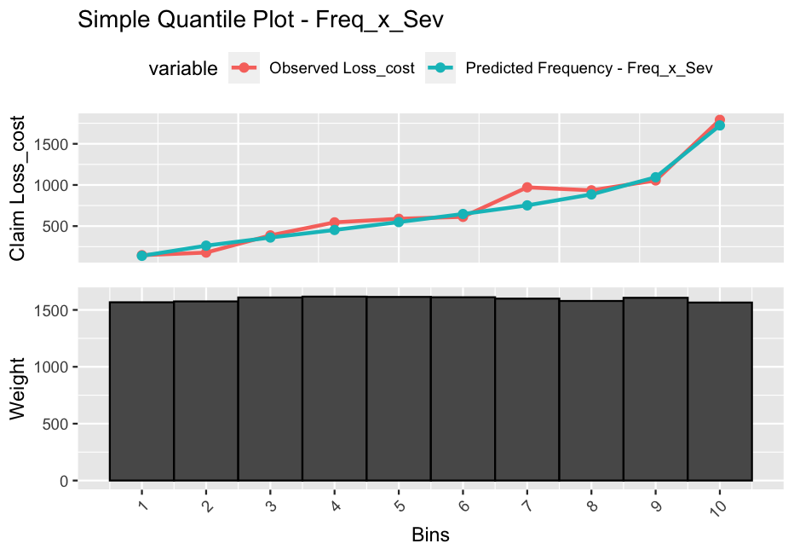
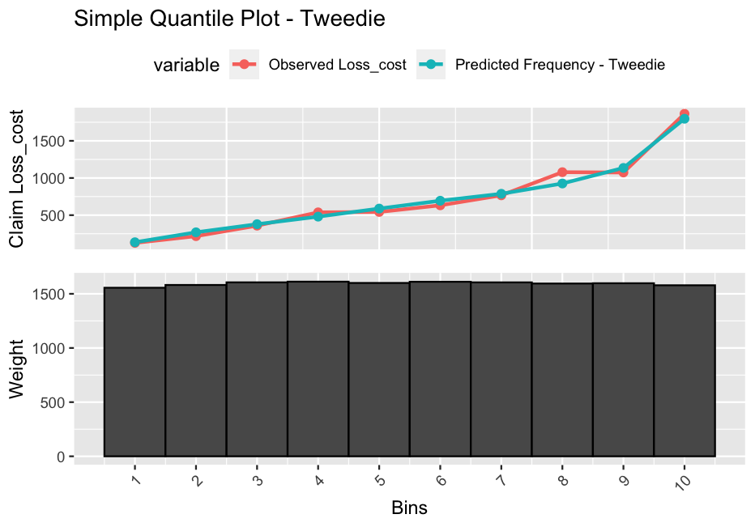
Simple Quantile Plot
Fit: large deviations in buckets 2, 4 and 7
Lift: similar lift to observed
Monotonicity: only two reversals, one very small
Fit: large deviation in bucket 8
Lift: similar lift to observed
Monotonicity: only two reversals, one very small

Slide 38
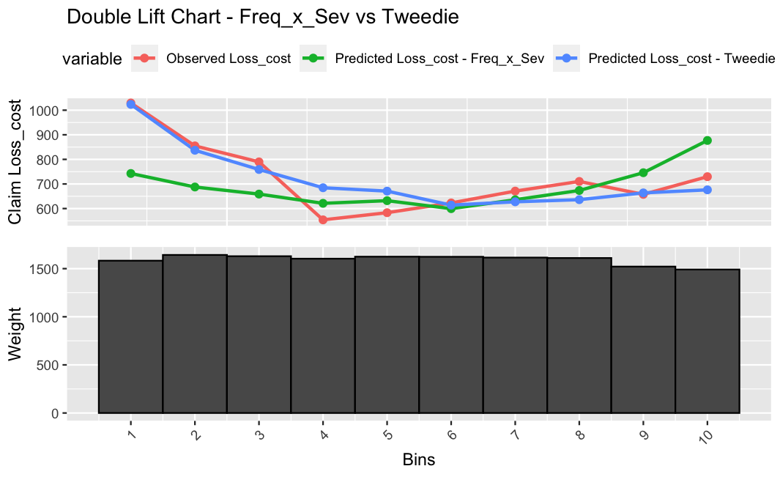
Double-Lift Chart
Tweedie’s fit is better at the ends.
FS’s fit is better in the middle, but not by much.

Slide 39
Holdout Gini Comparison
Frequency X Severity | Loss Cost Model
0.3650815 | 0.3741910
Considering the results from the holdout simple quantile plots, the double lift chart and the Gini comparison, we proceed with the Tweedie Model as our best fit model.
Notes:
ALSO DISCUSS:
Transformation of your selected model into a rating structure, including the average rate level assumed in policy year 2022:
The adjustor is the growth in frequency between that year (i.e. 2021 in our case) and 2022.
Any assumptions, limitations, or risks of which Ms. Model should be aware:
There is less insight for each of the frequency & severity model
Less stable since the data is mostly at 0

Slide 40
Thank You for Listening!

Slide 41
Appendix: Severity Model

Slide 42
EDA SUMMARY
Variate Name | Description | Included in Model? | Notes
Liab_driving_record_Ind | A 2-level categorical variate indicating whether the policyholder’s driving record is rated a ‘6’ or not. | Y | NAs were assumed to not be ranked ‘6’.
Marital_status_Ind | A 2-level categorical variate indicating whether the policyholder is married or not. | Y | Common law and same sex marital status’s were assumed to be married and all others were grouped into single. Not as significant as other predictors.
Num_at_fault_claims_past_1_yr_Ind | A 2-level categorical variate indicating whether the policyholder has an at fault claim in the past year prior to the policy’s effective date. | Y

Slide 43
EDA SUMMARY
Variate Name | Description | Included in Model? | Notes
Num_minor_convinctions | A continous variate for the number of minor convictions that policyholder has. | N | Not clear pattern on how it affects the response variate.
Num_yrs_since_fault | A categorical variate grouping policyholders by whether their last at fault claim was less than 5 years ago or more. | N | Not significant to the model.

Slide 44
Appendix: Tweedie Model

Slide 45
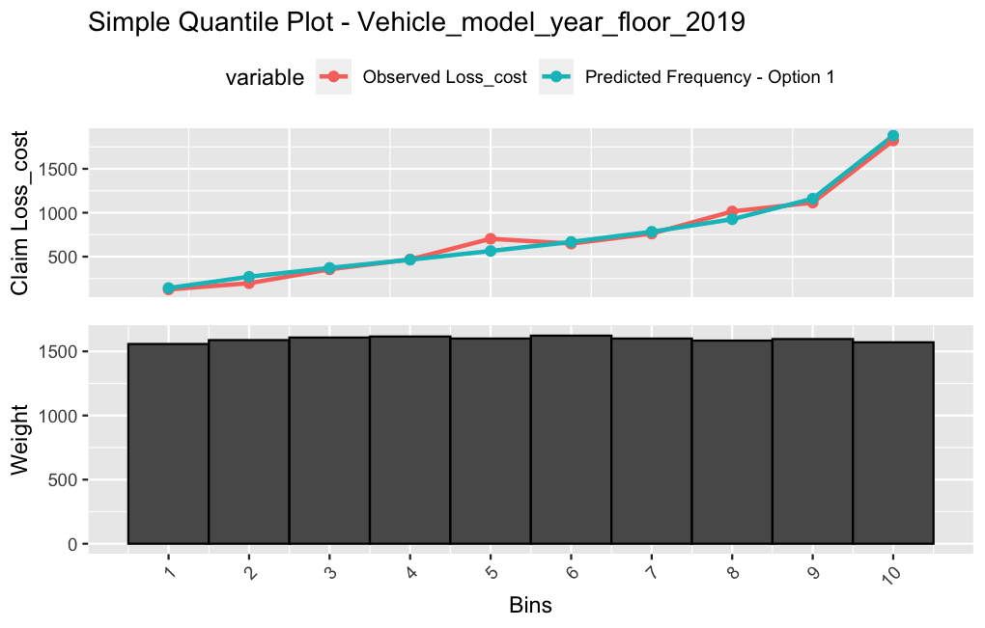
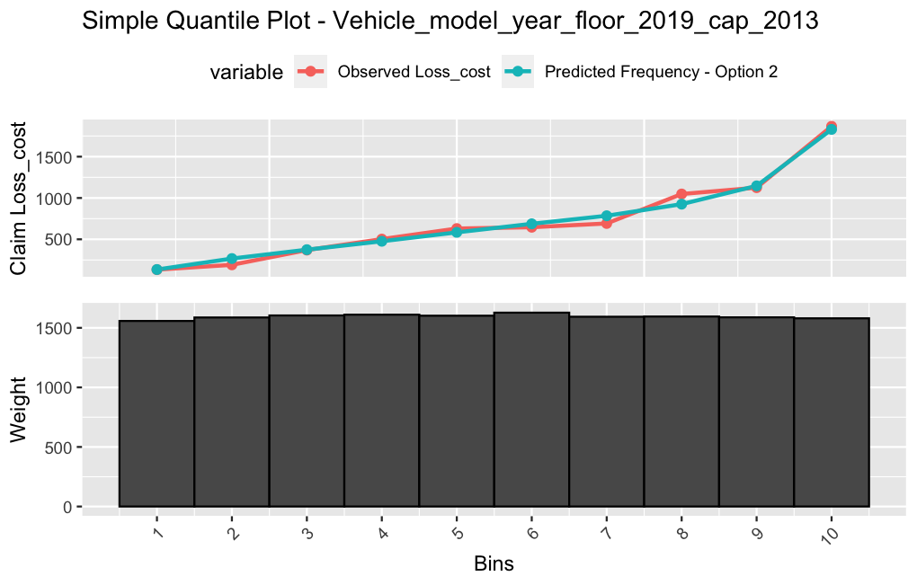
Holdout Testing – Simple Quantile Plot
Vehicle_model_year_floor_2019 vs Vehicle_model_year_floor_2019_cap_2013

Slide 46
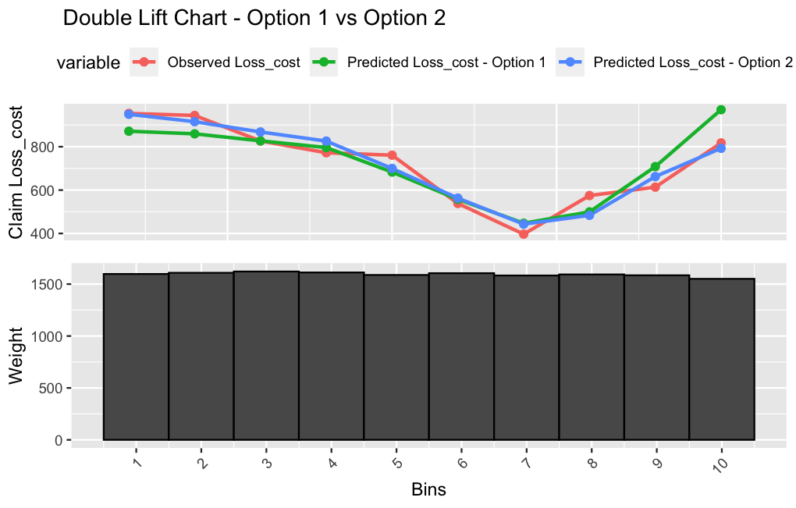
Holdout Testing – Double Lift Chart & Gini
Vehicle_model_year_floor_2019 vs Vehicle_model_year_floor_2019_cap_2013
 | Holdout Gini
Option 1 | 0.3718281
Option 2 | 0.3620364

Slide 47
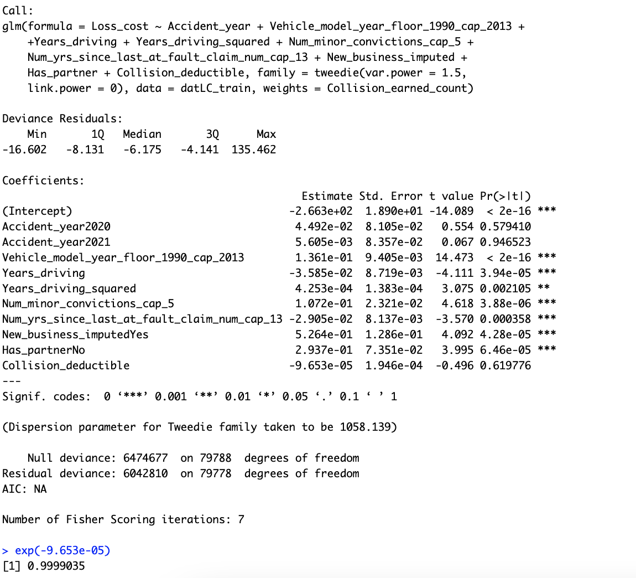
Tweedie – Deductible

